Slide 1


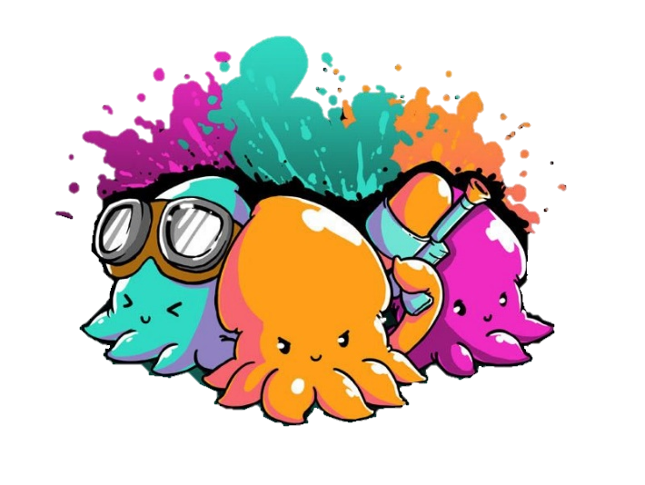




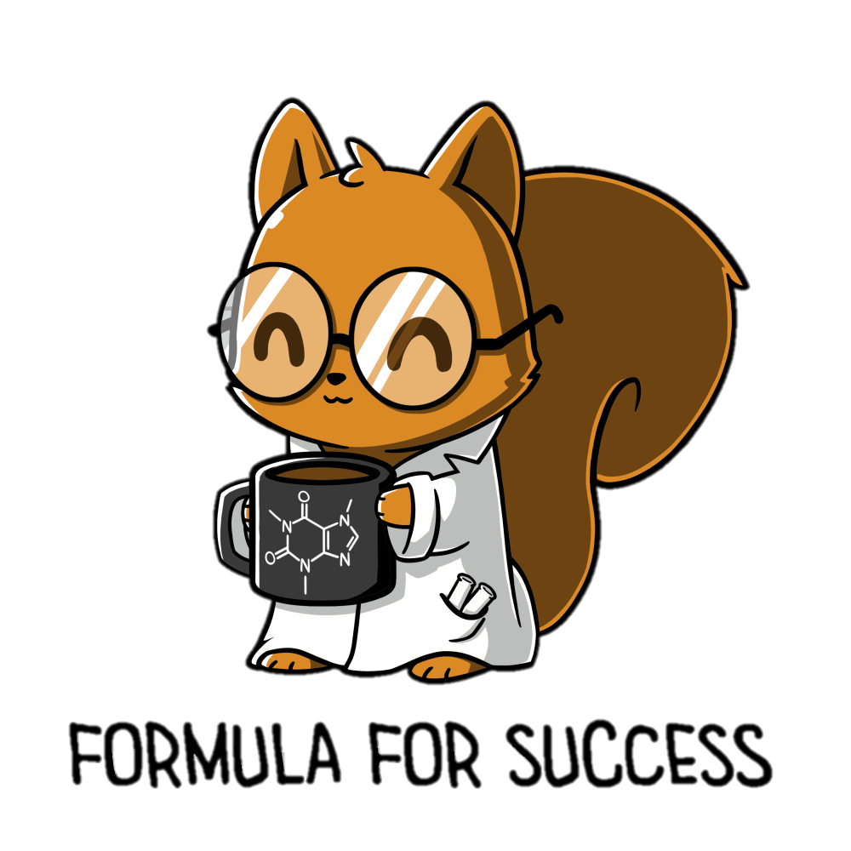
JUN
02
Whiteboards
Whiteboard markers
Pen/pencil
Revising ecology concepts
Complete ecology mini-quiz
Mark and review mini-quiz
Define key ecology terms
Explain key ecology terms
Apply understanding of ecology

Slide 2


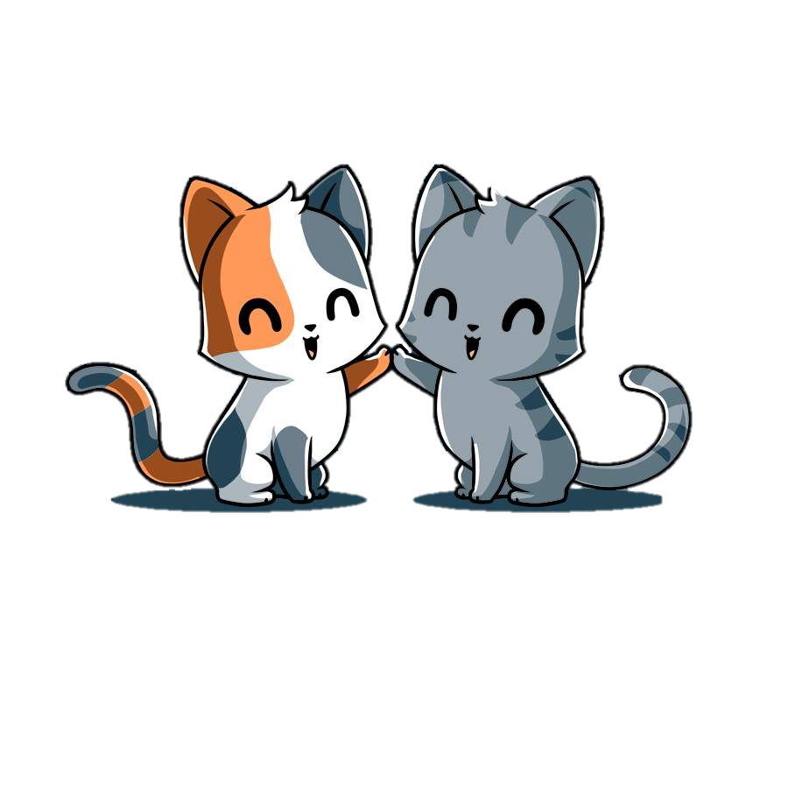

We are learning about:
Ecology
Define key ecology terms
Explain key ecology terms
Apply understanding of ecology

Slide 3
Ecology
Collect a whiteboard, marker & cloth
Remember to use your whiteboards to answer!
Get your brain ready…
It’s time to review your knowledge!

Slide 4
Remember
Ecology
1. The study of relationships between living things and their physical environment is.
Zoology
Ecology
Botany
Biology
2. A scientist who studies is a…
Chemist
Botanist
Ecologist
Zoologist

Slide 5
Remember
Ecology
3. What is the definition of environment?
All living and non-living things in an area
All of the non-living things in an area
All of the living things in an area.
4. True or False. The non-living factors of an ecosystem are known as biotic factors
True
False

Slide 6
Remember
Ecology
5. What is are examples of abiotic factors?
Water, sunlight and soil
Animals, plants and bacteria
6. Which biological level of organisations are included in an ecosystem?
Ecosystem, Biome, Biosphere
Community, Population, Organism
Biome, habitat, Organism

Slide 7
Remember
Ecology
7. When two organisms can breed to produce fertile offspring, they are…
Population
Species
Organism
Community
8. Where an organism lives is it’s…
Habitat
Environment
Community
Ecosystem

Slide 8
Remember
Ecology
9. An ecosystem is…
Many different species of organisms living together
A single animal living on its own
The place where organisms interact with each other
10. Interactions between two different organisms living in close physical association is known as..
Ecosystem
Interdependence
Symbiosis
Relationships

Slide 9
Remember
Ecology
11. Commensalism is when…
When one organism benefits and the other is hurt
When one organism benefits and the other isn’t hurt
When both organisms benefit
12. Which is an example of commensalism
Barnacles on a whale
Tapeworm in an animal
A hawk capturing a rabbit
Carbon dioxide/oxygen exchange between humans and plants

Slide 10
Remember
Ecology
13. Mutualism is when…
When one organism benefits and the other is hurt
When one organism benefits and the other isn’t hurt
When both organisms benefit
14. Which is an example of commensalism
Barnacles on a whale
Tapeworm in an animal
A hawk capturing a rabbit
Carbon dioxide/oxygen exchange between humans and plants

Slide 11
Remember
Ecology
15. Parasitism is when…
When one organism benefits and the other is hurt
When one organism benefits and the other isn’t hurt
When both organisms benefit
16. Which is an example of parasitism
Barnacles on a whale
Tapeworm in an animal
A hawk capturing a rabbit
Carbon dioxide/oxygen exchange between humans and plants

Slide 12
Remember
Ecology
17. What are the terms we use to describe organisms in ecosystems?
Carnivore, Herbivore, Detrivore
Consumer, Producer, Decomposer
18. Where does all energy in ecosystems come from?
The sun
Producers
Decomposers
Oxygen

Slide 13
Remember
Ecology
17. Producers are known as such because…
They produce oxygen
They produce energy
They produce food
They produce consumers
18. Consumers are known as such because…
They consumer energy
They eat
They can’t produce their own energy
All of the above

Slide 14
Remember
Ecology
19. How do food chains show the relationships in ecosystems
Arrows show who eats what
Use triangles to show traits of each species
Use squares to show ancestral relationships
20. The arrows in food chains show
The direction that an animal can travel
The order of animals from largest to smallest
The direction of the flow of energy
The direction of the flow of light

Slide 15
Remember
Ecology
21. Which organism is the first link of a food chain?
Producer
Consumer
Decomposer
22. Which level of consumers directly feeds on producers
First order (primary)
Second order (secondary)
Third order (tertiary)

Slide 16
Remember
Ecology
23. Which level of consumer is most likely to be at the top of the food chain and is very rarely preyed upon.
First order (primary)
Second order (secondary)
Third order (tertiary)
24. What is a food web?
The opposite of a food chain
The interaction of multiple food chains within an ecosystem
The interactions of one food chain within an ecosystem
The food eaten by one organism

Slide 17
Remember
Ecology
25. True or false. Food webs often show more than one predator for an organism
True
False
26. Visual ways to show who eats whom in an ecosystem is…
A food chain
A food web
Both

Slide 18
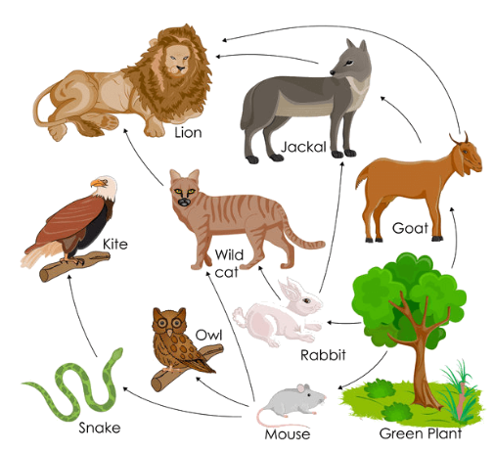
Remember
Ecology
27. In this food web, identify the primary consumers
Snake, mouse, rabbit
Rabbit, mouse, goat
Owl, rabbit, goat
Goat, owl, rabbit

Slide 19
Remember
Ecology
28. What would happen if the wild cat was removed from the ecosystem?
Nothing
Rabbit populations would increase
Goats would increase
Mice would decrease
Lions would decrease

Slide 20
Remember
Ecology
29. What does the two “R’s” in MRS C GREN stand for?
Respire & Respond
Respire & Reproduce
Respond & Regrow
30. Why do organisms adapt?
Help organisms to survive
Because its cool
Survival is hard
Adaptation leads to evolution

